Slide 1
What genres of movies do best in terms of ratings and revenues?

Slide 2
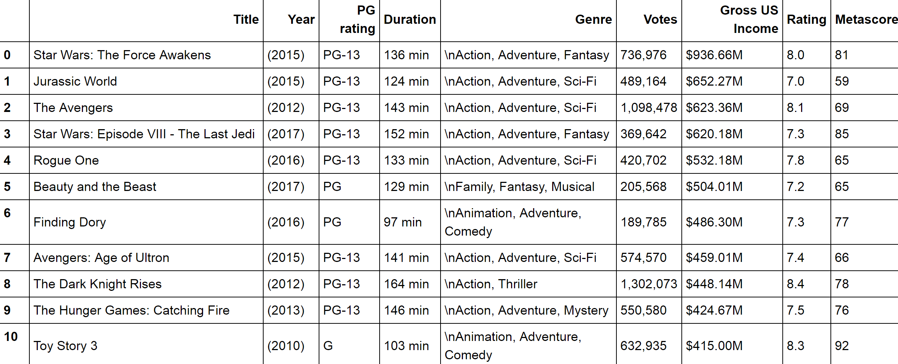
Data Collection from IMDB- Sorting according to the Gross US Income:

Slide 3
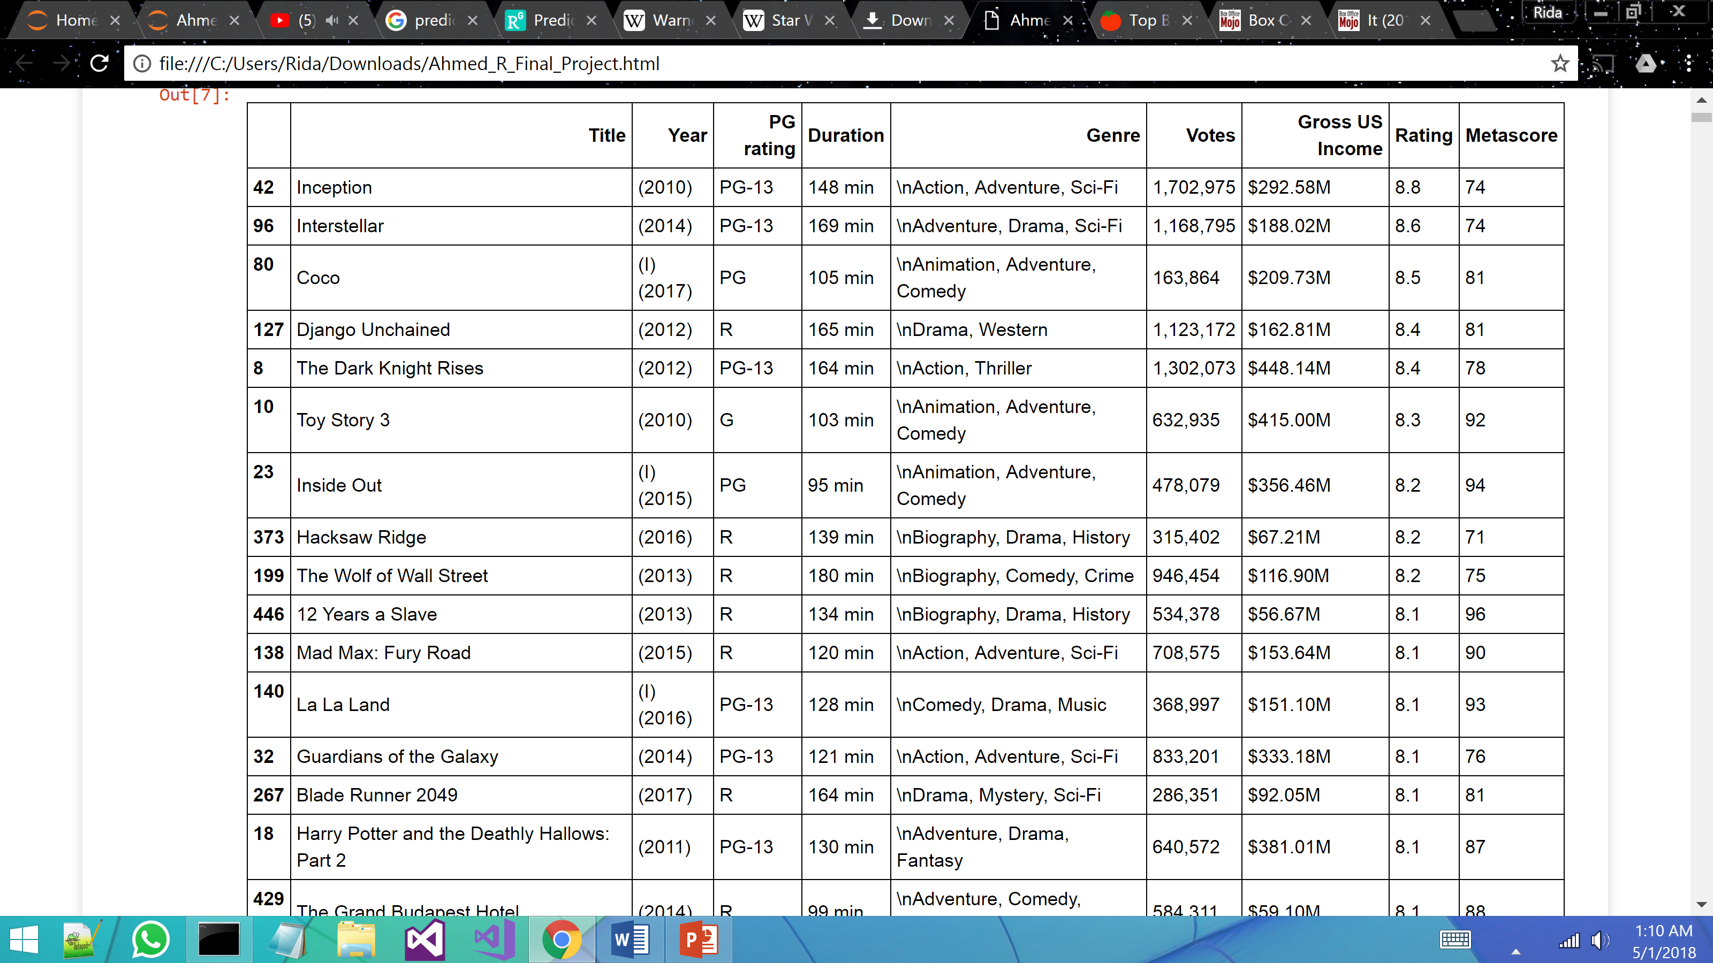
Data Collection from IMDB- Sorting according to Ratings:

Slide 4
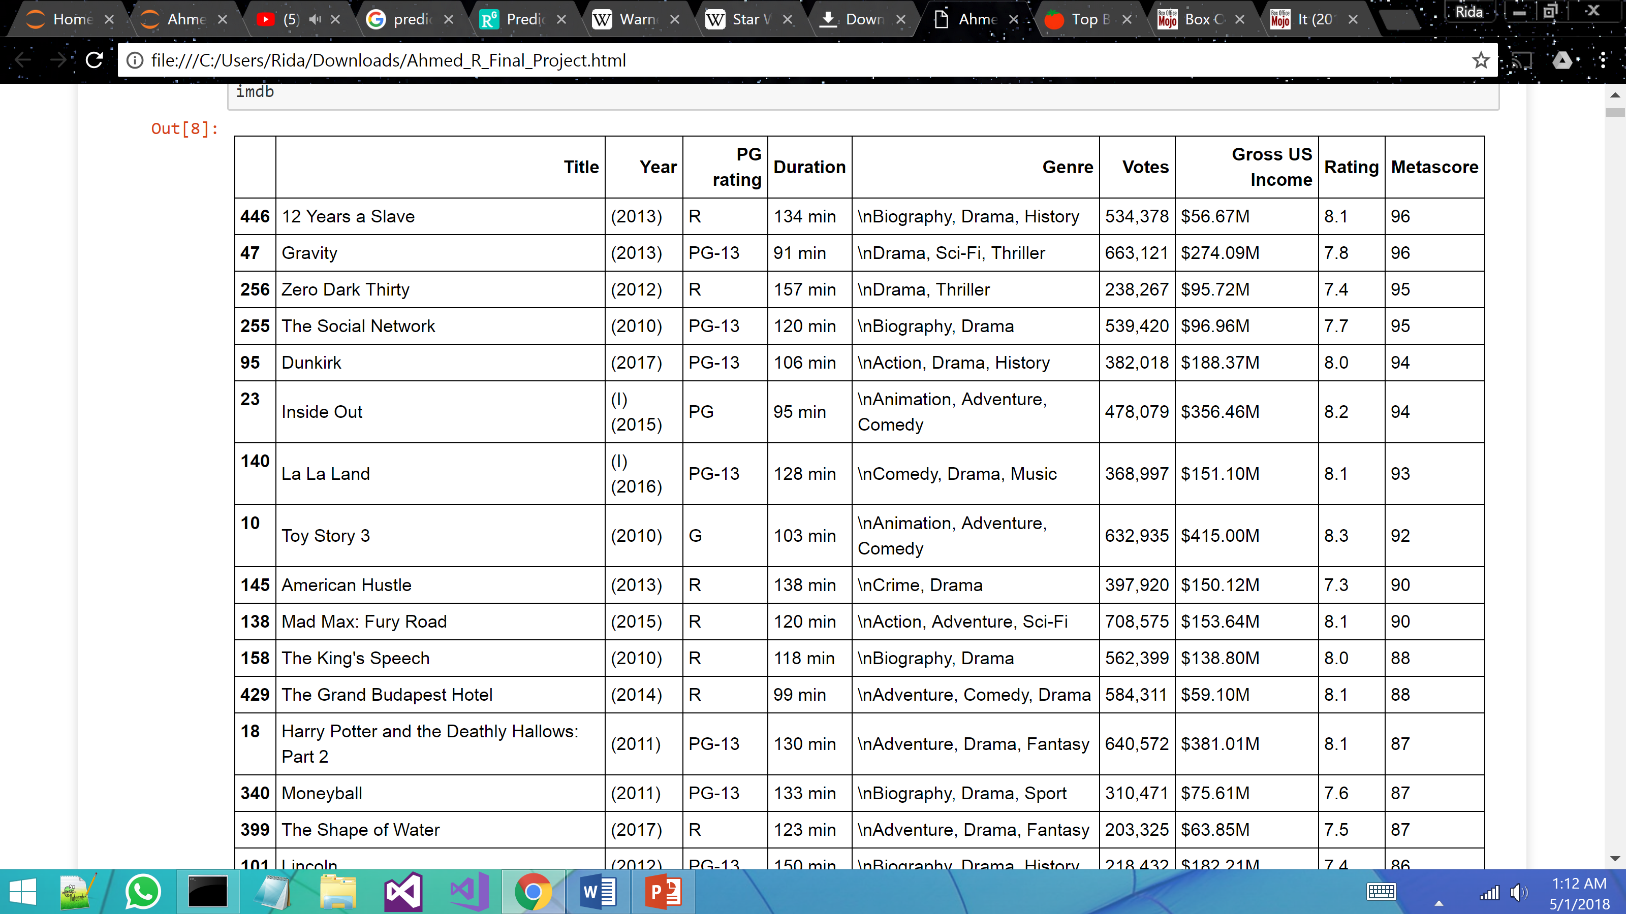
Data Collection from IMDB- Sorting according to the Gross US metascore:

Slide 5
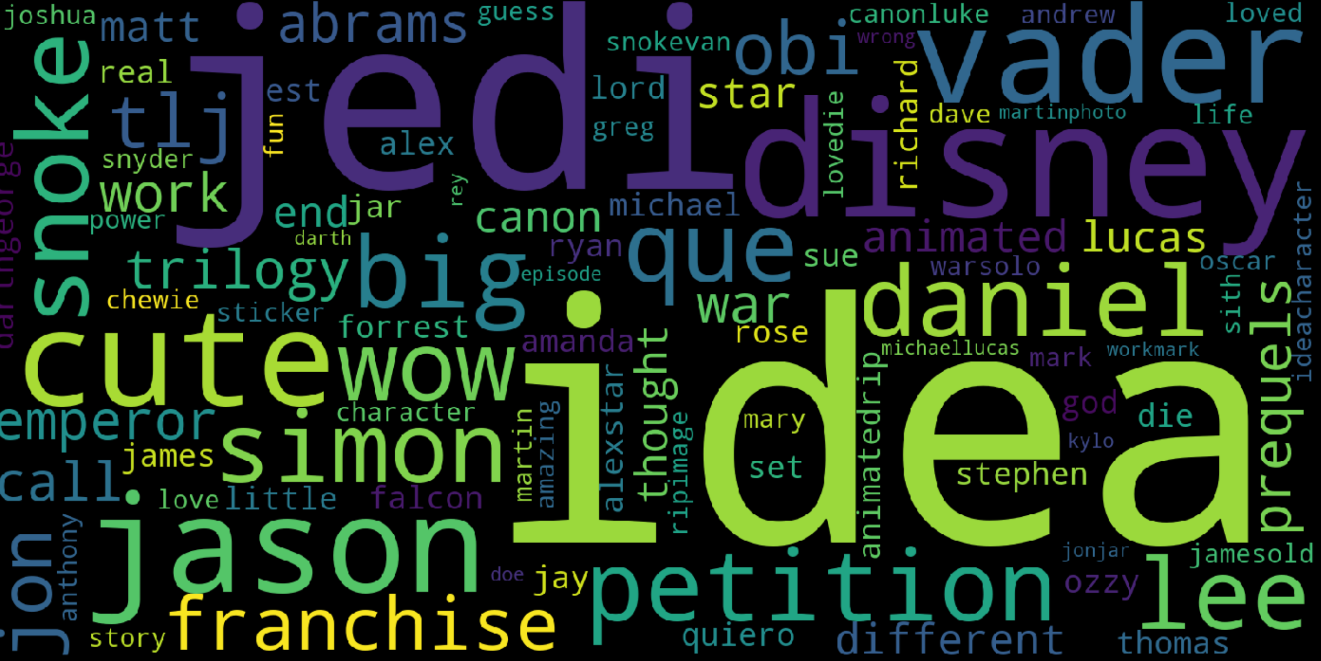
Data collected from Facebook Fan pages: The Force Awakens

Slide 6
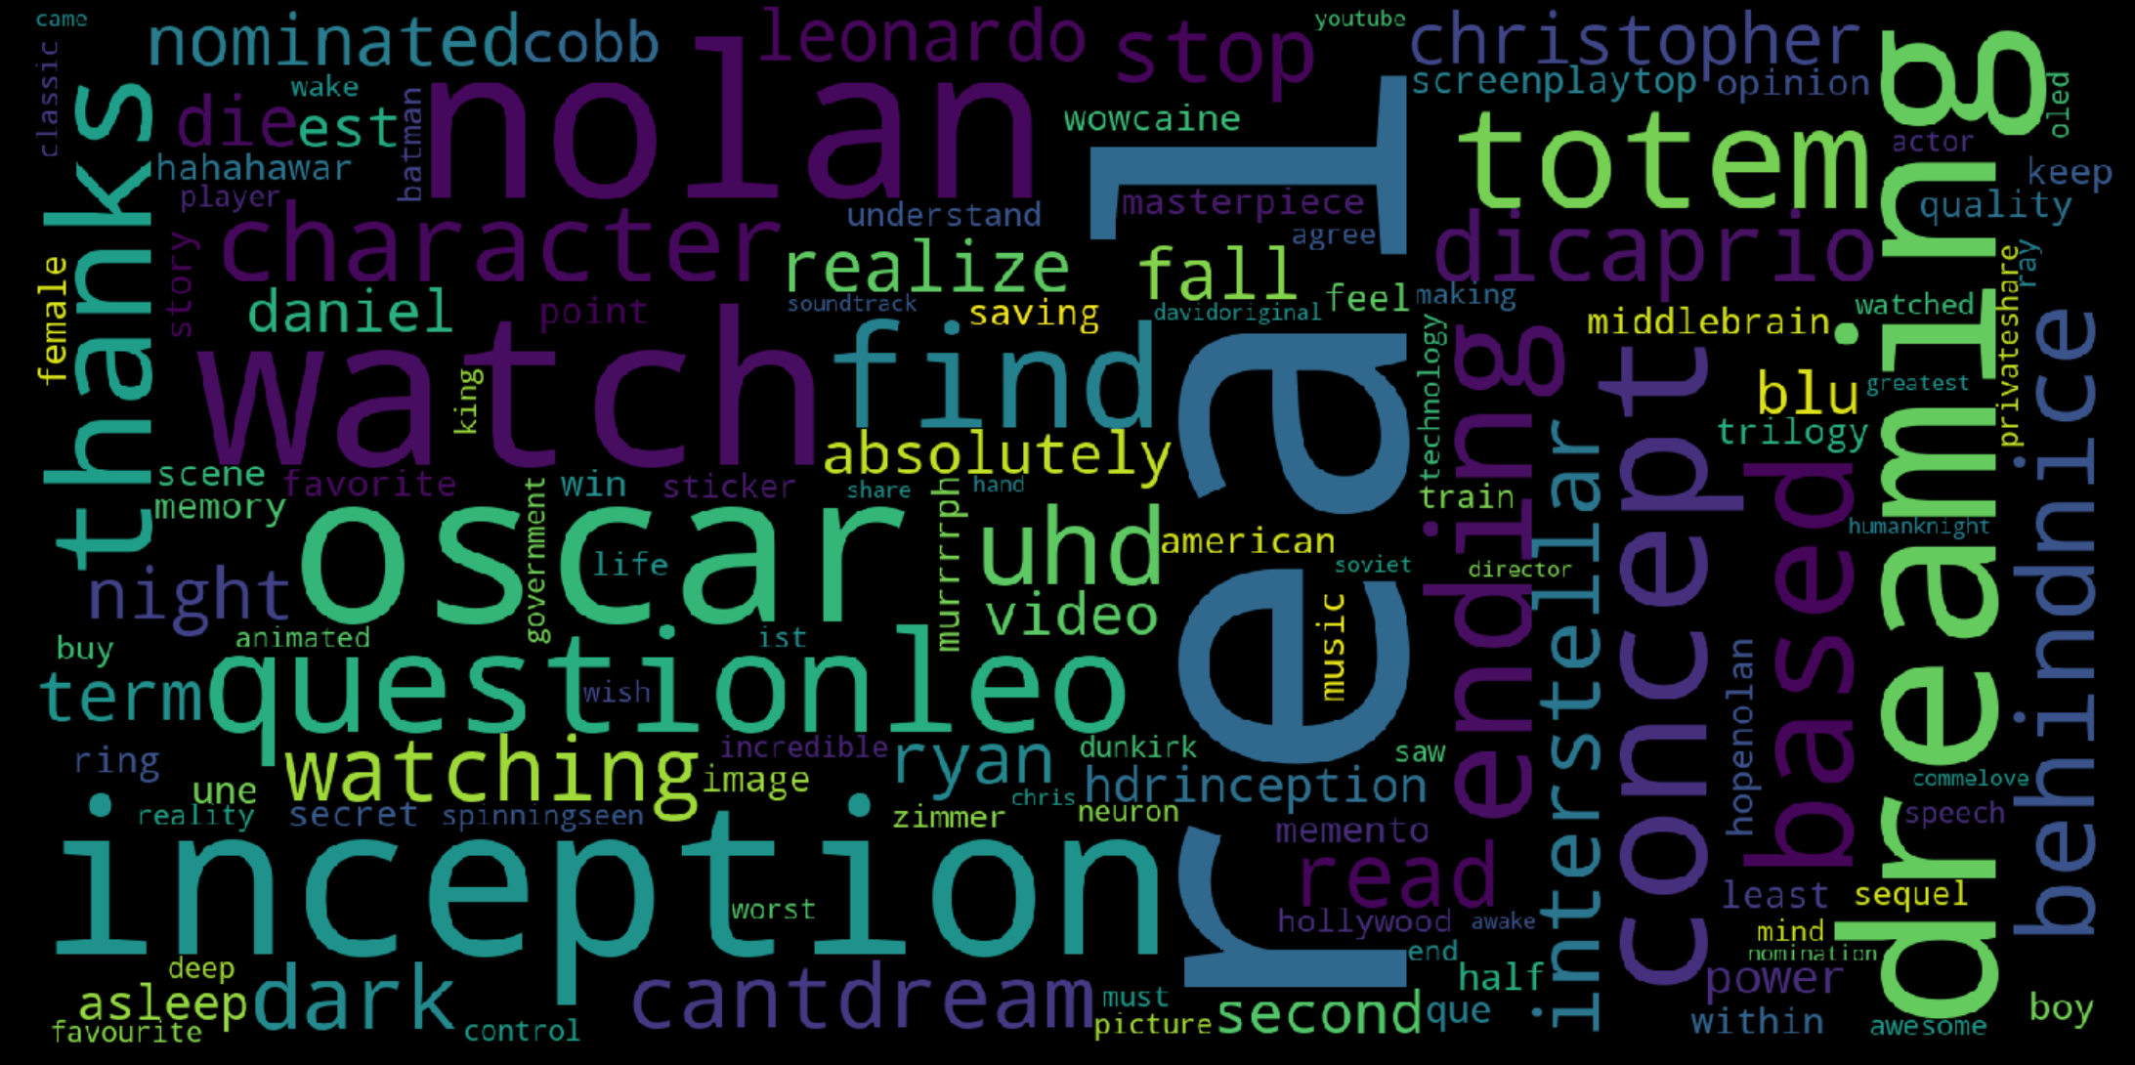
Data collected from Facebook Fanpages: Inception

Slide 7
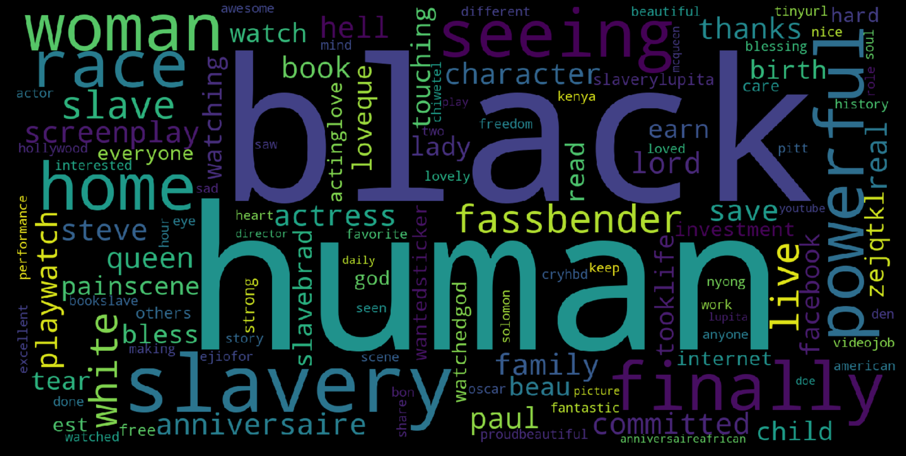
Data collected from Facebook Fanpages: 12 years slave

Slide 8
Twitter data:
According to the tweets collected about people's movie preferences, it can be seen that the most popular movies were the ones about:
1. Films that highlight love stories preferably those that are exceptionally emotional. The words 'love', 'beautiful' and 'cry' were associated with these movies.
2. A specific movie, Black Panther was quite popular during the time the tweets were collected. Along with this, Twitter users talked about comedy movies with storylines revolving around powerful characters and their love interests just as much as they did about Black Panther which means there was a tie between these 2 topics.
3. The third most popular topic on our customized Twitter search was Marvel and its derivations like mcu which stands for Marvel Cinematic Universe. The words 'first' and 'time' are heavily involved which suggests that movies from this production house are starting to attract a larger audience than they did in the past.
4. This can be seen as being an extension of the third topic. It was concerned with kids movies, movies about superheroes and movies based on comics. Some of these movies had several sequels as the storyline was too broad to depict in a single film thus explaining the mention of 'collection' in this topic. There was frequent use of the word 'award' which implies that these movies were noticeably successful.
5. Disney movies were deemed popular by twitter users at the time of data collection. Along with that, movies based on the lives of famous personalities, biographies and autobiographies were a hit. Moreover, movies based on books were also appreciated by the audience.

Slide 9
Results:
Overall, research on movies from the past decade reveals that for movies to do well and achieve higher box office ranks, they must check at least one of the following boxes:
be a Sci-fi movie that uses robust special effects and animations
be a Marvel movie based on their comics
follow a non-fictional plot, one that depicts historical events that are understudied and under-represented
released during the Summer, especially applies to movies that are directed towards young adults
include a star-studded cast which ensures that the audience will watch the movie no matter what the story is like

Slide 10
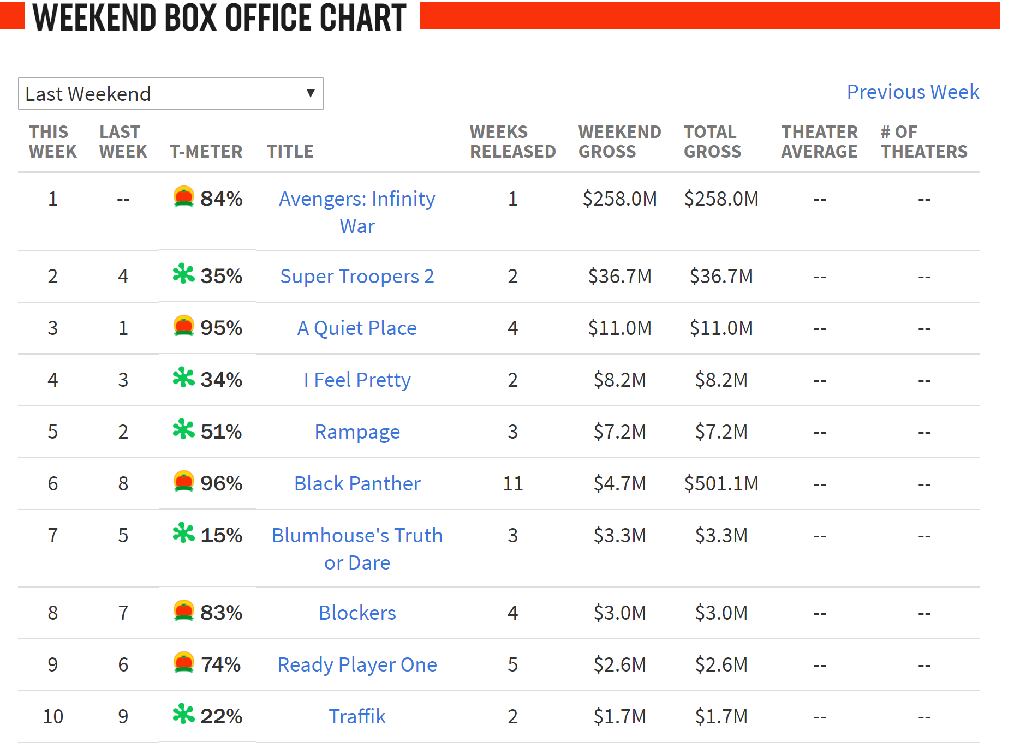
application: Using Rotten Tomatoes

